Slide 1
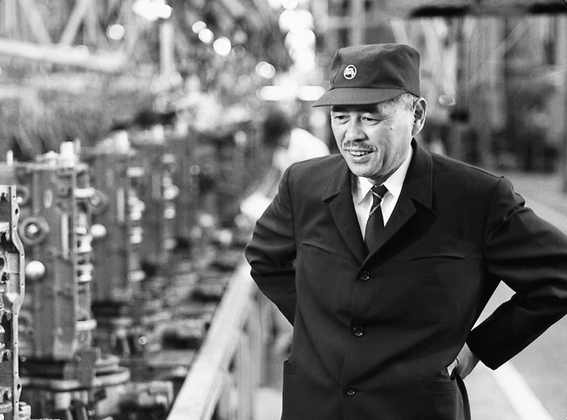
Kanban
&
Gunnison’s Visual Test Management Solution
Presented to: Gunnison
Date: 4/25/2013

Slide 2

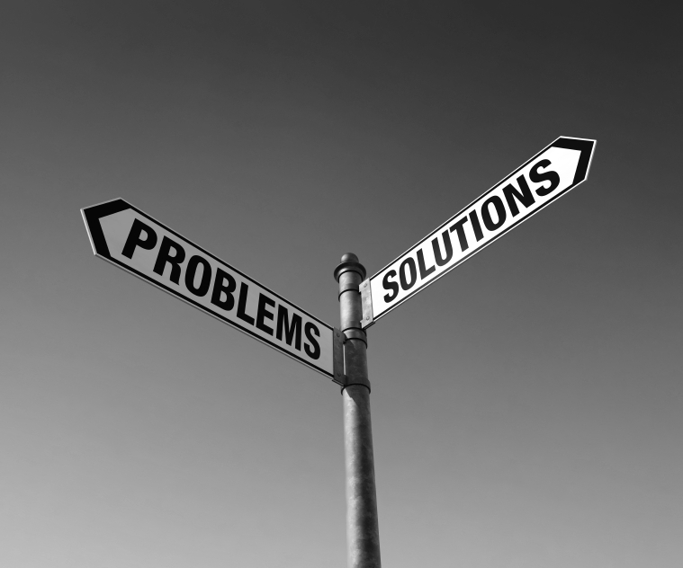
Topics
K a n b a n

Slide 3

Kanban at NCS: Vanguard Workbench*
The problems:
Releases were often delayed
Requirements weren’t clear
Uncertainty about what SCs really needed or wanted in the tool
*Vanguard Workbench is a tool developed by S-3 for use by Study Centers to view the MDES, run reports, and validate their XML files against existing XML schemas

Slide 4

Kanban at NCS: LimeSurvey
The problems:
No collaboration with anyone who understood the requirements
Development done on all surveys but not any one survey fully completed
Surveys deployed with defects

Slide 5
Our Solution
Kanban

Slide 6
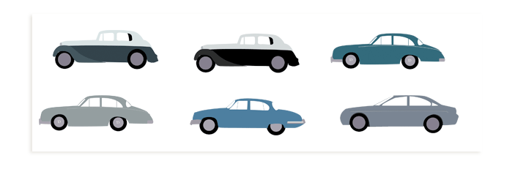


What is Kanban?
Process developed by Taiichi Ohno at Toyota to find a system to improve and maintain a high level of production.
Utilizes a “pull” system based on the actual demand of the customers (make what’s needed instead of making all we can just in case).
A method for JIT (just-in-time) production.

Slide 7
Kanban for
Software Development
Kanban is not a software development methodology, it is a method
Requires that a process is already in place so that Kanban incrementally changes the underlying process
Kanban
Waterfall Model
RUP
eXtreme Programming
Spiral Waterfall
Scrum
predictive
adaptive
rigid methodologies
iterative methodologies
agile methodologies

Slide 8
Kanban for
Software Development
Traditional Project Management – triple constraint: scope, schedule, budget
Agile Project Management – possibly agreed upon schedule but scope is negotiable; still similar to traditional project management during the iteration/sprint
Kanban – no promises based on uncertainty as with traditional or agile project management; it offers a commitment to a level of service and to things that customers truly value based on their priorities
The traditional approach to forming a commitment around scope, schedule, and budget is indicative of a one-off transaction. It implies there is no ongoing relationship.
Kanban is based on the notion that the team will stay together and engage in a relationship over a long period of time. It implies a commitment to a relationship not just to a piece of work and therefore a higher level of trust.

Slide 9
Kanban for
Software Development
Promoting incremental change has been controversial in the Agile software development community
Kanban suggests that teams should not adopt a defined method or process template. Kanban might empower individuals and teams evolve their own unique process solutions, which allows for innovation.

Slide 10
Kanban for
Software Development
One project could have several different teams, each with their own kanban board
Each team’s situation is different and evolves their process to fit their context. However, the processes are derived from the same principles.

Slide 11
Kanban for
Software Development
Kanban principles:
Start with what you do now
Agree to pursue incremental, evolutionary change
Respect the current process, roles, responsibilities & titles
Visualize the workflow
Limit Work In Progress
Manage Flow
Make Process Policies Explicit
Improve Collaboratively
Notes:
We have

Slide 12
Kanban for
Software Development
Kanban principles in action:
  Focus on Quality
  Reduce Work-in-Progress
  Deliver Often
  Balance Demand Against Throughput
  Prioritize
  Attack Sources of Variability to Improve Predictability
  Enables Lean/Agile/Collaborative Culture

Slide 13
Kanban for
Software Development
  Focusing on Quality
  Code inspections
  Collaborative analysis
  Use of design patterns
  Modern development tools
  Reduce quantity of design-in-progress

Slide 14

Kanban for
Software Development
  Reducing Work-in-Progress
  Shorten iterations to drive higher quality
  Limit work in progress
  There is a causation between quantity of work-in-progress and average lead time.

Slide 15
Kanban for
Software Development
  Delivering Often
  Frequent releases build trust
  Small releases provide evidence that software development teams can deliver and are committed to providing value
  Reducing W.I.P reduces lead time and shorter lead times mean more releases
In Gunnison We Trust

Slide 16
Kanban for
Software Development
  Balancing Demand Against Throughput
  Set the rate at which new requirements are accepted into the software development pipeline
  Doing so effectively fixes the work-in-progress to a given size
  As work is delivered, more requirements are pulled from the people creating demand
Limiting W.I.P through B.D.A.T creates slack. Slack enables continuous improvement. Therefore optimizing for utilization is not desirable and impedes the creation of an improvement culture.

Slide 17
Kanban for
Software Development
  Prioritizing
  Optimize value being delivered
  Can only be done after team has learned to consistently build high-quality code, reducing WIP, shortening lead time, releasing often, and balancing demand against throughput
  Take action to optimize business value

Slide 18
Kanban for
Software Development
  Attacking Sources of Variability to Improve Predictability
  Requires knowledge workers to change the way they work, learn new techniques, and change their personal behavior
  For mature organizations
  Variability results in more WIP and longer lead times

Slide 19
Kanban for
Software Development
Kanban will cut costs:
  Transactional costs – setup activities, cleanup, delivery
  Coordination costs – scheduling, emails, meetings, stand-ups
  Failure load costs – new value-added work generated because of an earlier failing; work that uses capacity that could have been used for new value-added, revenue-generating features
Implementing the previous 6 steps will cut down on all of these costs. Quality on the front end decreases failure load costs and the transparent and visual nature of Kanban cuts down on transactional and coordination costs.

Slide 20
Back to our problems: Vanguard Workbench
The problems:
Releases were often delayed
Requirements weren’t clear
Uncertainty about what SCs really needed or wanted in the tool
How did we utilize Kanban to solve this?

Slide 21
Kanban at NCS: Vanguard Workbench
The solution:
Introduced Kanban to the S-3’s software development effort for Workbench.
  Visual management via kanban board
  Limit the work-in-progress
  Closer collaboration with SCs to determine their priorities
  Make Workbench development effort completely transparent to everyone

Slide 22
Back to our problems: LimeSurvey
The problems:
No collaboration with anyone who understood the requirements
Development done on all surveys but not any one survey fully completed
Surveys deployed with defects
How did we utilize Kanban to solve this?

Slide 23
Kanban at NCS: LimeSurvey
The solution:
Introduced Kanban to the instrument development effort for LimeSurvey.
  Documented their workflow
  Focused on quality – found over 150 defects in first phase of testing—this built trust with LimeSurvey developers
  Introduced work-in-progress limits
  Balanced Demand Against Throughput
  Prioritization
  Deployed 4 defect-free surveys in 4 weeks. Zero completed in the prior 6 months.
  "It is taking significantly longer to test instruments than originally anticipated. This is due to the very fine-grained level of detail in the testing that Gunnison group is performing. The finalized instruments are of extremely high quality."

Slide 24

Gunnison’s Visual Test Management a.k.a “Testban”
Slacking off—kanbanning the Kanban:
  Our team thought that if we could kanban the entire development effort then why not try using kanban on just the testing effort?
Plan –
  Create a kanban board that captured the most informative aspects of the testing effort as possible for that application
  Make it as transparent as possible so that anyone could go in and see exactly what was going on with testing at that very moment
  Level production so that we could focus on quality without worrying about rework
  Give it a cool (?) name

Slide 25
Gunnison’s
Visual Test Management Solution
Agile/Lean
Leverages Kanban
Can be implemented with a variety of tools
Not disruptive to existing processes

Slide 26
Questions?
E n d

